Slide 1
Sprint 3
MICHAEL TRINH, CHRIS TROUNG, CHASE WALKER

Slide 2
Features added since sprint 2
We added a lot of new feature for the game. This includes the additions of the random pickup system where while traveling to the location you want to go to; you pass by an object where you can be given a choice to either pick it up and use it or just walk pass it or the choice to encounter a random battle. Speaking of fighting, we also made it possible where you can fight and eliminate mobs as well. The fighting system operates kind of like a pokemon/final fanatasy. You will be given the choice to fight, use an item, or just run like a coward. We will also give the enemy some personalty since we don’t want to fight someone plain!
For this portion of the coding, Michael made write the def function for traveling and fighting system and Chris wrote the traveling() for the menu. Chase wrote the fighting system for the game as he had some of his ideas for each of the enemy. We all contributed to planning how to go coding the game, the final boss themselves, and creating the enemy together . Chris was responsible for the song choices like always.

Slide 3
Next Sprint
We have to give the player a health and level system so the charcter in the game doesn't feel like a God in the game. Since we are in a time crunch, we planned to finished everything under a day. This including the initial plans to finish up the project and debug the program before we demonstrate it for the class without doing the Sprint. Since we just have to add the health/level exp, Michael will create the def function for it, Chase will write the health/exp portition and Chris will finish whatever is left with the group help of course.

Slide 4
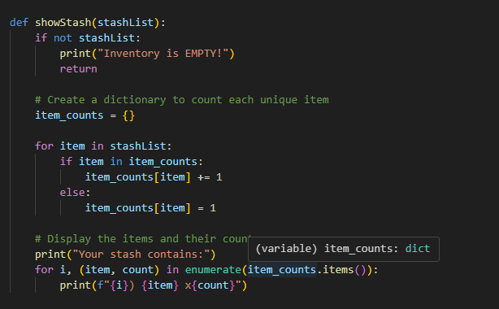
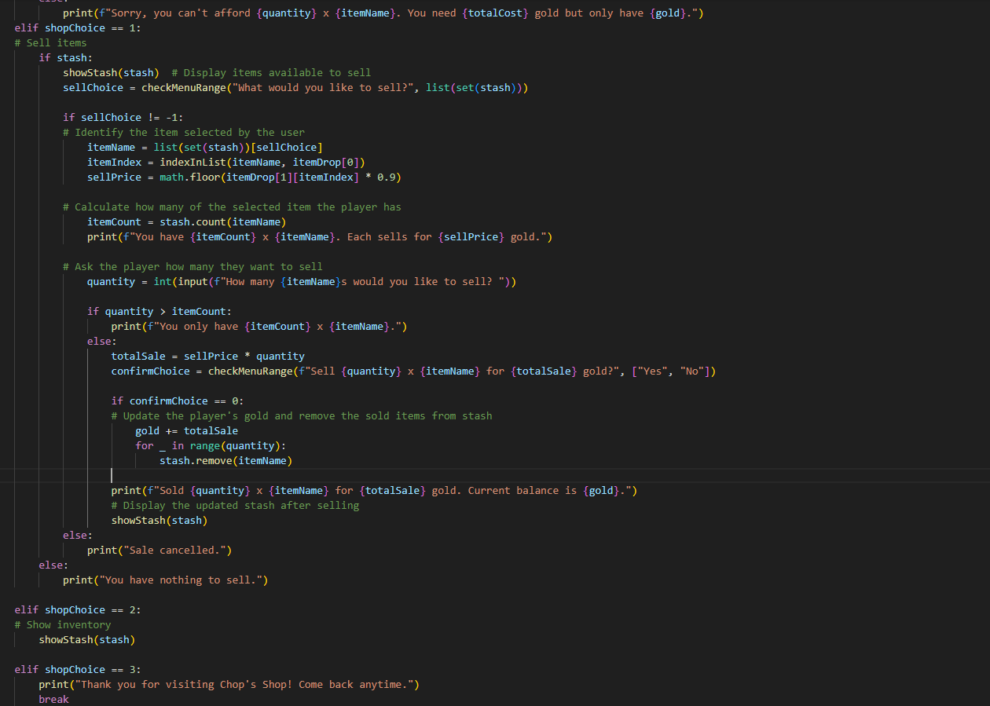
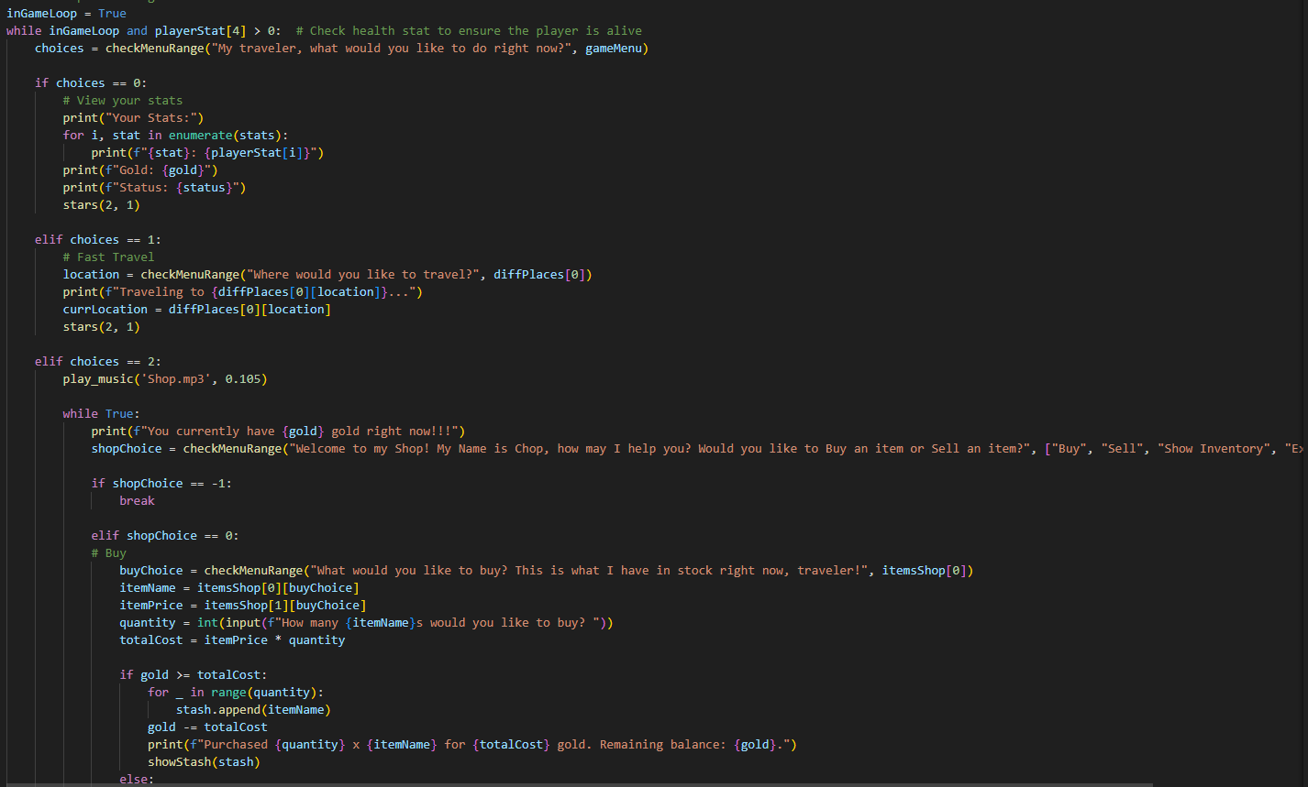
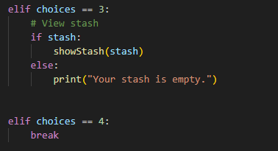
Our code/demo

